Slide 1
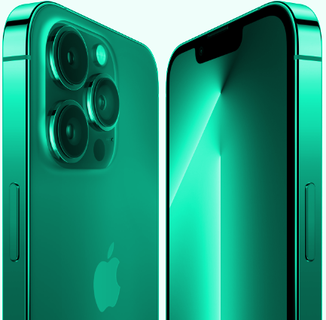
APPLE JACKS
Marketing Analytics Project (BADM 590)

Slide 2







THE TEAM

Slide 3
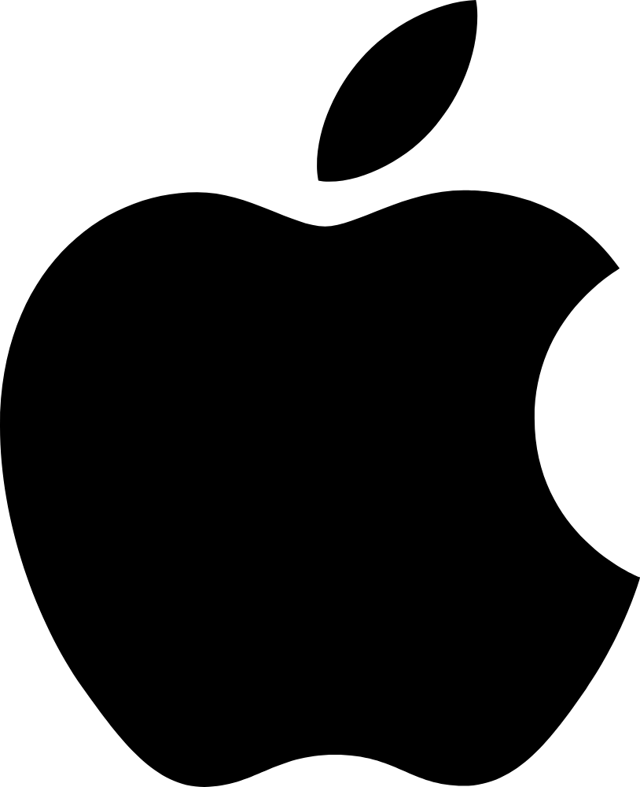
OUR COMPANY
APPLE INC.
Apple designs, manufactures, and markets smartphones, tablets, personal computers (PCs), portable and wearable devices. The company also offers software and related services, accessories, and third-party digital content and applications
It’s the first company to reach a $3 trillion market value in 2022, having previously broken records by becoming the first company with a $1 trillion and $2 trillion market cap.

Slide 4
SWOT ANALYSIS
STRENGTHS
WEAKNESSES
OPPORTUNITIES
THREATS
Apple’s high prices makes it possible for the company to sell a small number of products and still rake in a large amount of revenue
Apple’s prices make it a luxury company in developing countries, thus driving away most middle-class and lower-class potential customers
The design and manufacturing of products aimed at middle-class and lower-class consumers will enable Apple to increase its already high revenue and market cap
As most customers have recent versions of their products, Apple’s yearly revenue yield at new product launches seems to be reducing year by year

Slide 5
DATA OVERVIEW
Data Collection
Data Statistics
Data Size
The number of tweets for iphone models 12, 13 & 14 are 3318, 6820, 9831 respectively
Each of these file sizes are 4 MB on average
Scraped the data for sentiment analysis from twitter using twitterR package
Process was repeated thrice for each of the iPhone models namely 12, 13 & 14
We have also collected stock price and Apple’s Ads spent on twitter data from the web
The date range for our tweets is 7th Nov - 12th Nov 2022
The stock prices and Ads spent data is also for the same time period

Slide 6
HYPOTHESIS
Iphone 14’s customer satisfaction has a positive effect on stock prices
Iphone 14 has a higher customer satisfaction than iphone 13 and iphone 12
Iphone 14’s customer satisfaction increases with increase in Apple’s Twitter Ads spend.

Slide 7
PROJECT STAGES
STEP 2: Sentiment vs Stock Prices
STEP 1: Sentiment Analysis
STEP 3:
Apple Twitter Ad spend vs Sentiment
Analyzing the impact of sentiments from tweets on fluctuation in Apple’s Stock Prices
Scrape data from twitter for text analysis to identify general perception of iPhones on Twitter
Comparing Apple’s expenditure on twitter ads and sentiments of customers

Slide 8
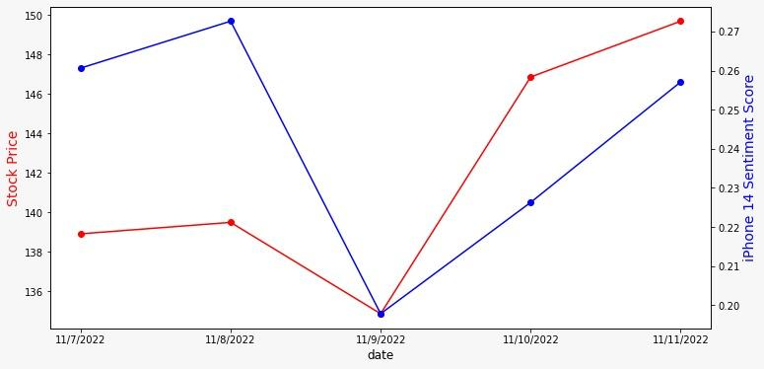
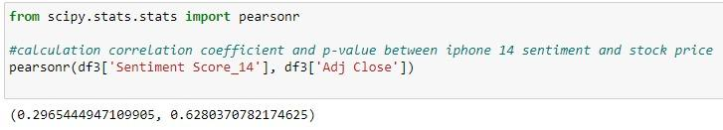
HYPOTHESIS 1: Iphone 14’s customer satisfaction has a positive effect on stock prices
The graph does suggests that both sentiment score and stock prices show similar trends between 7th Nov - 11th Nov
The above pearson’s correlation result however suggests that the relation between customer sentiment stock prices is not statistically significant
This may be due to the small sample size of data (7 days)

Slide 9
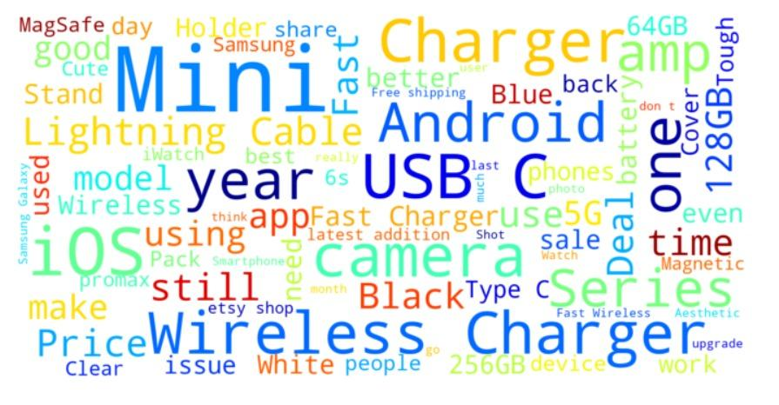
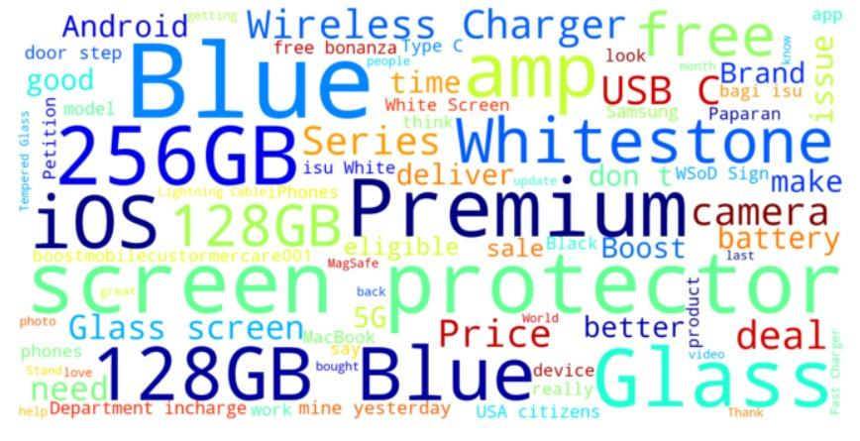
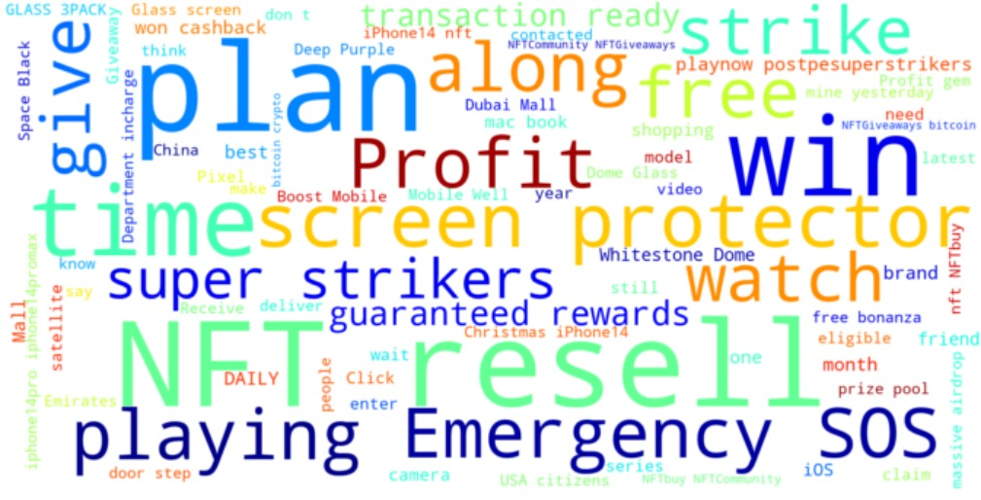
WORD CLOUD
iPhone 12
iPhone 13
iPhone 14
Iphone 14’s word cloud highlights words like “NFT”, “Profit”, “win” etc., which further suggests a positive influence on stock prices by customer satisfaction
Most of the features like resolution, display, camera etc.,are similar for iphone 13 and 14, however there is an additional feature of satellite connectivity for emergencies in iphone 14

Slide 10
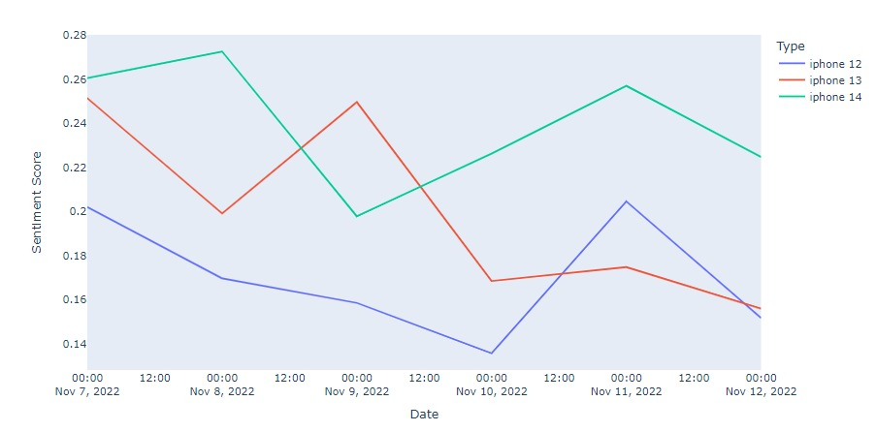
HYPOTHESIS 2: Iphone 14 has a higher customer satisfaction than iphone 13 and iphone 12
As can be seen from the graph above, iphone 14 has a higher average sentiment score as compared to iphone 12 and 13
However, on November 9th 2022, we see that iphone 13 has a higher sentiment score than iphone 14

Slide 11
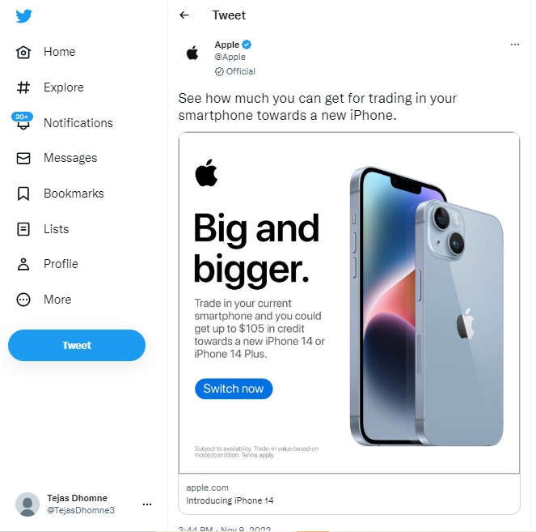
We can attribute this sentiment increase to a tweet made by Apple on 9th November 2022
We believe people may be comparing phone 13 and 14 given the trade-in discount introduced for the new product

Slide 12
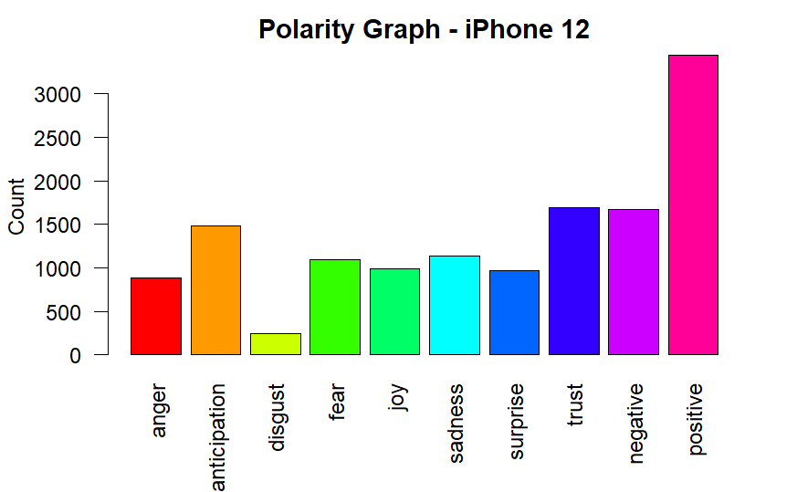
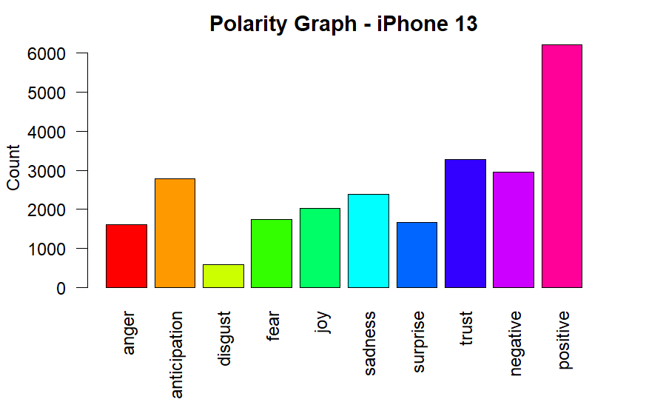
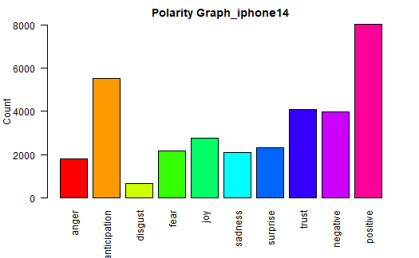
POLARITY
iPhone 12
iPhone 13
It is clear from the graphs that the new product iphone 14 has received a positive response from the customers
The anticipation is also high for iphone 14, which may be due to the new product buzz in the market

Slide 13




Slide 14
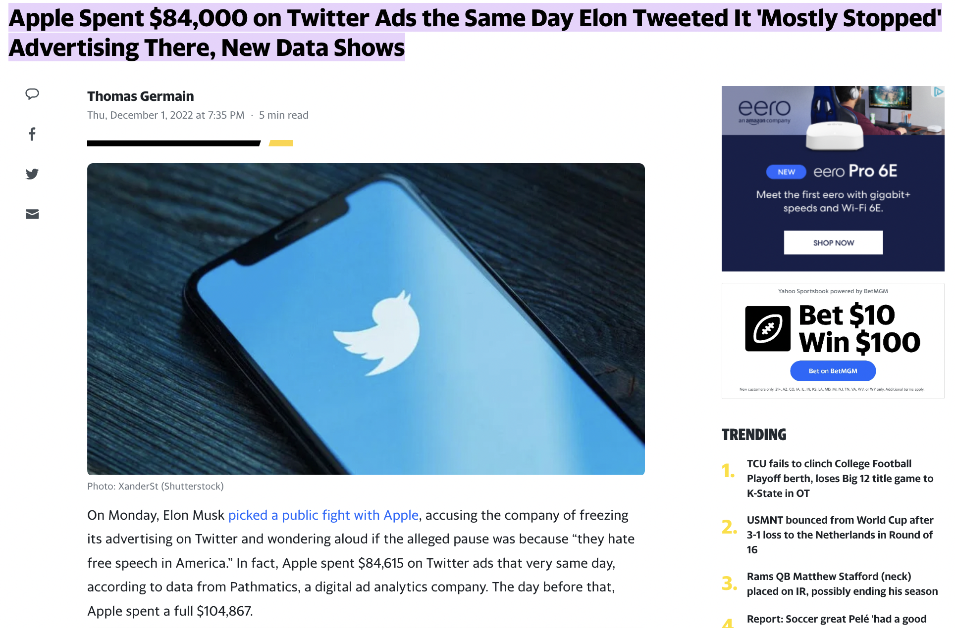
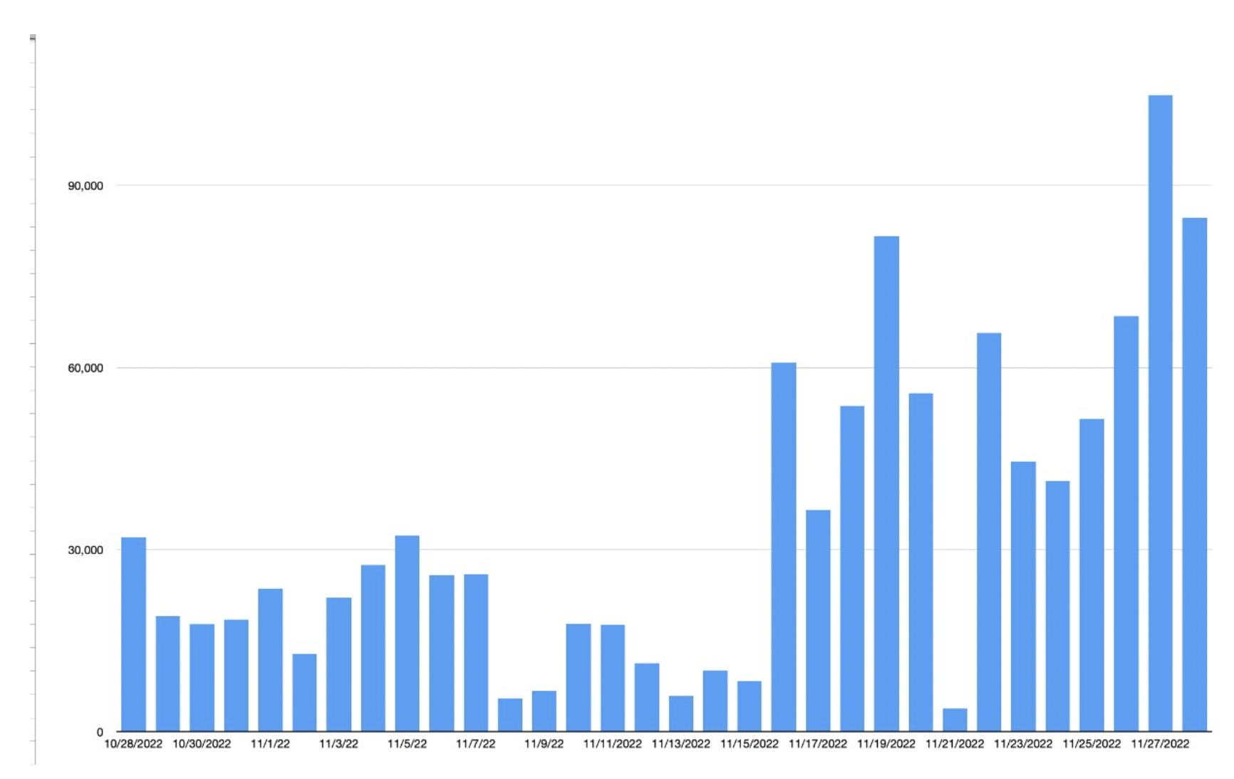

Slide 15
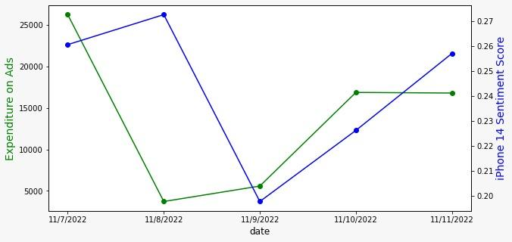
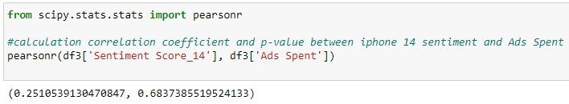
HYPOTHESIS 3: Iphone 14’s customer satisfaction increases with increase in Apple’s Twitter Ads spend.
The graph does suggests that both sentiment score and Ads spent show similar trends between 7th Nov - 11th Nov, except 8th Nov
Through our research, on Nov 8th general elections were held and Apple might not have felt the need to spend on Ads. Additionally the sentiment score was also maintained.
The sentiment score decreased significantly on Nov 9th, from where Apple started increasing the Ads spent on Twitter again
However, the above pearson’s correlation result suggests that the relation between Ads spent and customer sentiment score is not significant

Slide 16

Limitations
Having one week of data may be a barrier for implementing Machine learning models
The analysis might not generate accurate results bearing in mind the limited data we used for assumptions.
The standard Twitter API allows you to scrape tweets posted within 7 days and limits the number to 18,000 per 15 minutes.

Slide 17
Recommendations
With the launch of a new Apple product, Twitter tweets may help in prediction of stock prices
Customers prefer newer products launched by Apple and may initiate comparison with the older products if some offers/Trade offs are introduced
Since the Ad Spend on twitter has a higher impact on the customer sentiments, it is advisable to increase the marketing budget share of twitter ads

Slide 18


